Slide 1
EIA ON
PORTS & HARBOUR
So let’s get started!!!!

Slide 2
Table Of Contents
01
02
03
04
05
Introduction
EIA Requirements
Environment Impact of Port
Impact of location of Port
Impact of ship traffic
06
07
08
09
10
SWM
Impact on marine life
Mitigation
Positive Impacts
Conclusion

Slide 3
Presentors!
Shivay Bhandari
(1905398)
Aditya Beri
(1905439)

Slide 4
01
Introduction
You can enter a subtitle here if you need it

Slide 5
Introduction
EIA (Environmental impact assessment) is the process of investigating the environmental, social, and health consequences of a planned development.
It examines the environmental implications of the planned development and allows for environmental clearance decisions to be made.

Slide 6
Continued……
Over the last decade, the Asia-Pacific area's economic development has outpaced that of any other region on the planet.
As a result, seaborne cargo throughput has expanded dramatically in the region's main ports served by the Economic and Social Commission for Asia and the Pacific (ESCAP)

Slide 7
Continued……
While the expansion of port infrastructure can contribute significantly to economic development and the increase of marine trade, it can also have a negative influence on the surrounding environment.
Port construction and operation should thus be designed with the environmental implications in mind.

Slide 8
02
Requirements for EIA
You can enter a subtitle here if you need it

Slide 9
Requirement for EIA
Port development may create a wide range of impacts on the environment by dredging, construction work, landfills, discharges from ships and waterfront industries, cargo operations, and other port related activities.
Water pollution, contamination of bottom sediments, loss of bottom habitat, damage to marine ecology and fisheries, beach erosion, current pattern changes, waste disposal, oil leakage and spillage, hazardous material emissions, air pollution, noise, vibration, visual pollution, and other unhealthy socio-cultural impacts are all potential negative effects of port development.

Slide 10
Continued……
Environmental Impact Assessment (EIA) procedures have become crucial in minimising the negative consequences that port development projects may have.
Design, location, and operational adjustments can be implemented through this procedure to mitigate the negative effects of the development.

Slide 11
03
Environment Impact of Port Development

Slide 12

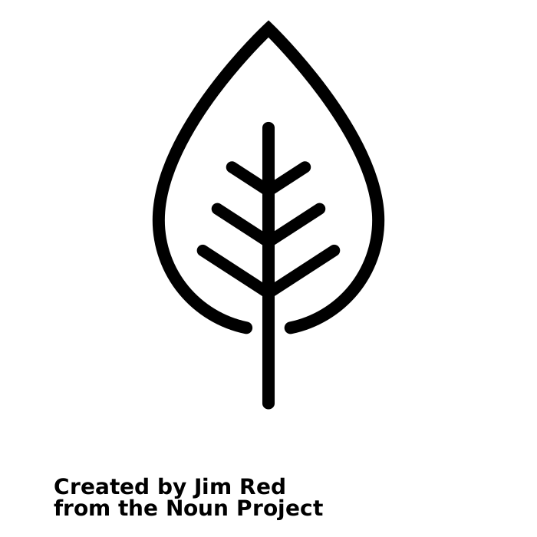
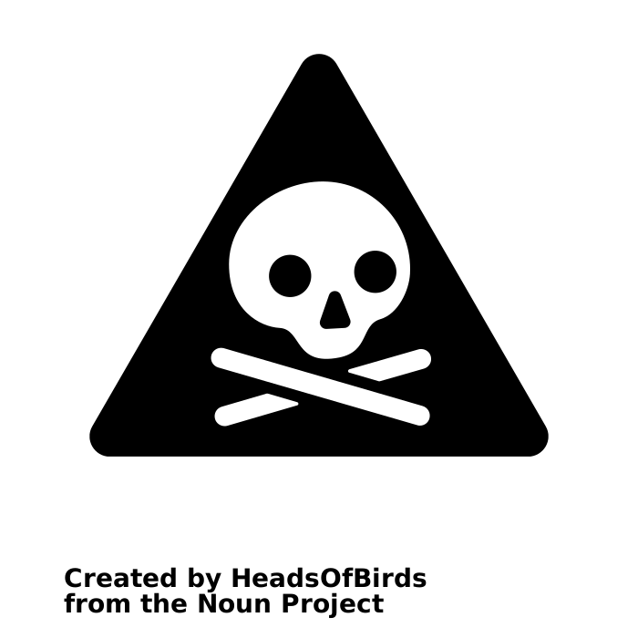
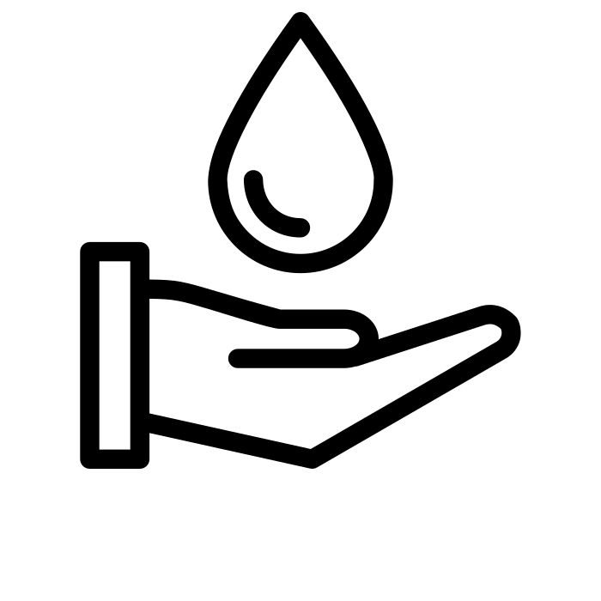
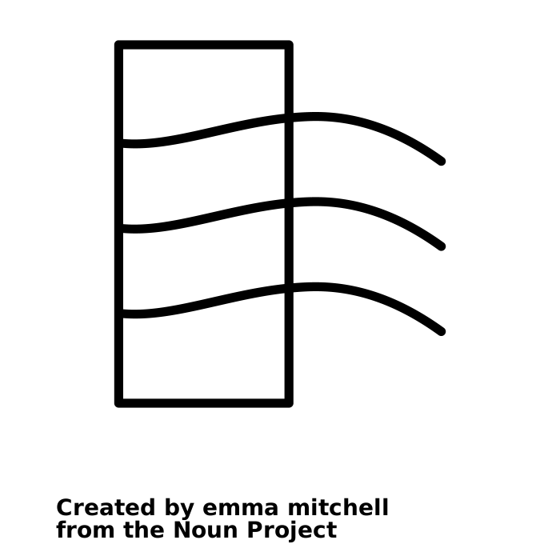
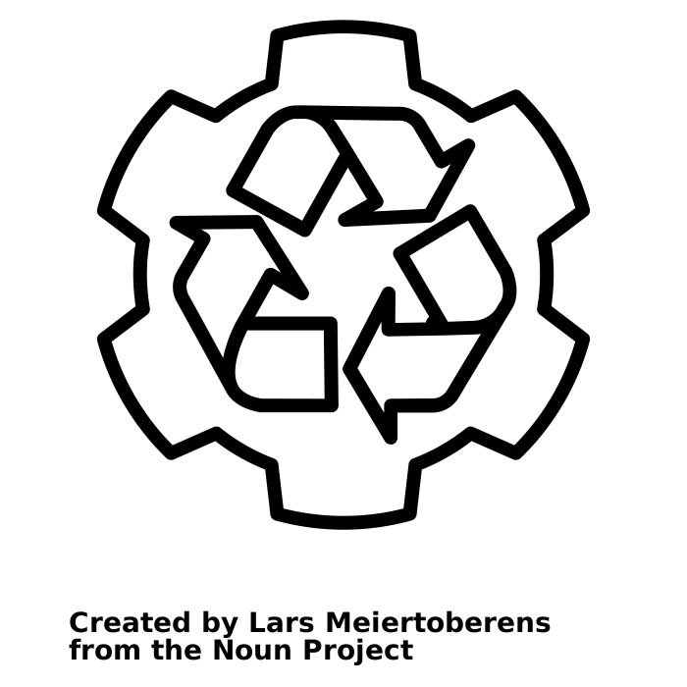
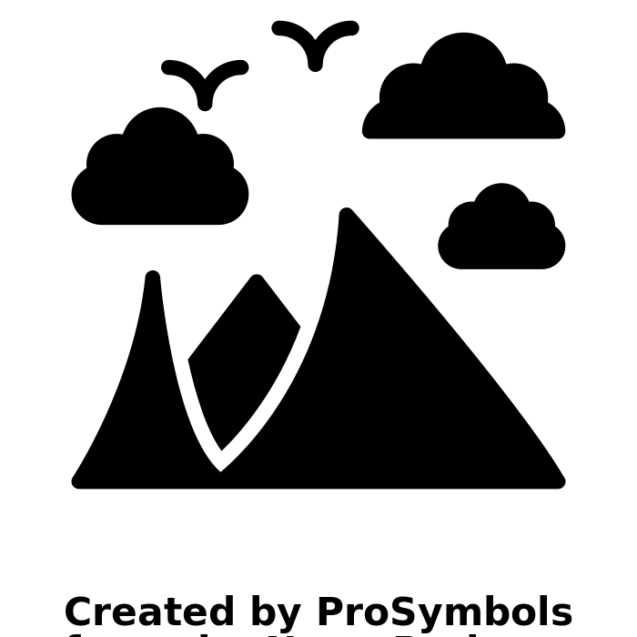
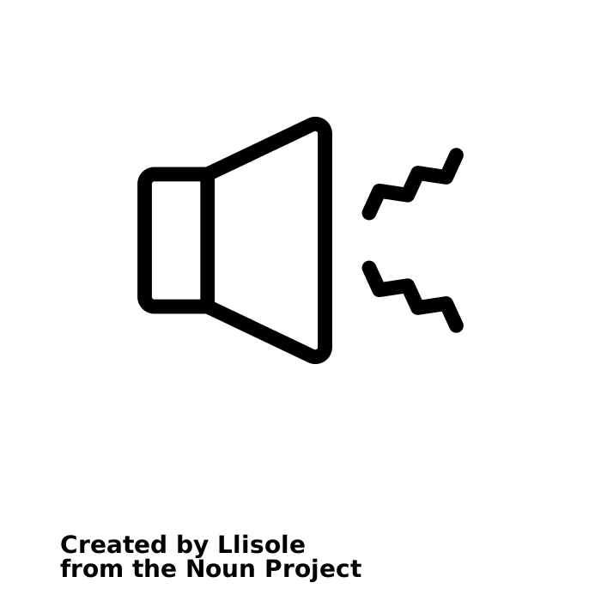
Water Quality
Coastal Hydrology
Bottom Contamination
Marine & Coastal Ecology
Air Quality
Noise & Vibration
Waste Management
Visual Quality

Slide 13
04
Impact of Location of Port

Slide 14
Potential Impacts on Water Quality
Potential Impact on Coastal Hydrology
Potential Impacts on Bottom Contamination
Breakwaters and landfills can disrupt current patterns and cause water to remain behind the buildings. If municipal or industrial wastewater flows into a port, stagnant port water may degrade due to algae growth, which causes a rise in phytoplankton and a decrease in dissolved oxygen.
Because of differences in wave refraction, diffraction, and reflection, the location of a port can produce changes in current patterns and littoral drifts.
The placement of a port may accelerate silt deposition in stagnant water behind structures, contaminating the sea floor.

Slide 15
05
Impact of Ship Traffic & Discharges

Slide 16
Potential Impacts on Water Quality
Potential Impact on Air Quality
Ship emissions that potentially pollute water include bilge water, ballast water, oily wastes, sewage, rubbish, and other ship leftovers. Spills of oils, lubricants, fuels, and other greasy substances might also pollute the water.
Ships might be a source of airborne emissions such gases, smoke, soot, and fumes. N02 and S02 are common pollutants produced by ships during manoeuvring and berthing, and they can contribute to air pollution in the surrounding area.

Slide 17
06
Solid Waste Management

Slide 18
Solid Waste Management
(SWM)
Construction waste consists mostly of spoils created by dredging. The disposal of dredged material on land may result in plant damage, loss of vegetation, leaking of polluted materials and salt, odour, an ugly view, and other nuisances to the surrounding population.
The following waste categories are managed inside ports and harbours:
Oil
Sewage
Garbage
Paint scraps and maintenance waste
Dredged material
These pollutants' discharges and spills create oil pollution, floating rubbish, unhygienic conditions, odour, and other deterioration of water and marine life.

Slide 19
Continued……
Technological breakthroughs in safety and environmental protection, new ship designs, enhanced operational skills, and maritime transportation operations have all aided progress.
Improvements have also been achieved as a consequence of the implementation of port waste management strategies and improved knowledge of the difficulties connected with pollution from ships and boats among port and harbour users.

Slide 20
07
Impact on Marine Life

Slide 21
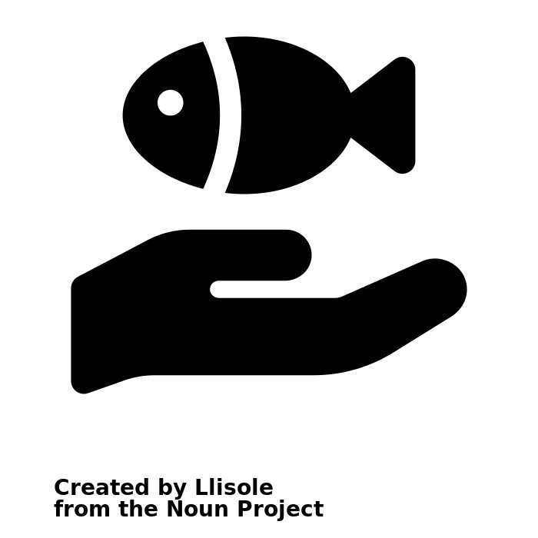
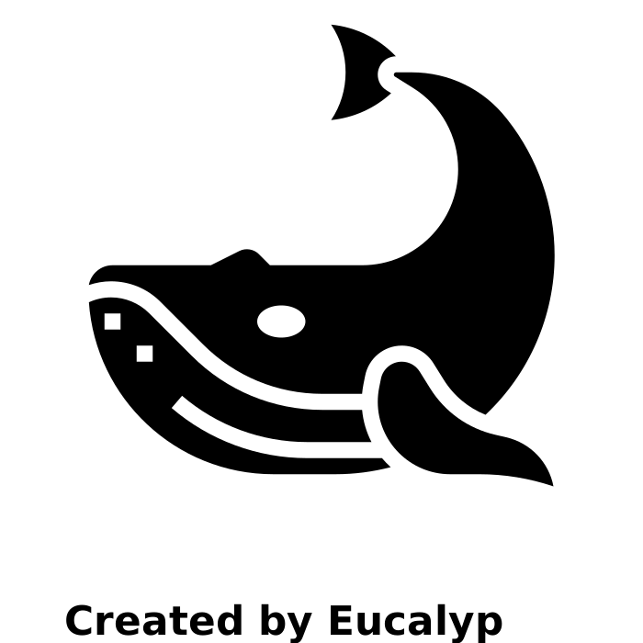
Impact on Marine Life
The location of a port may affects aquatic fauna and flora through changes of water quality, coastal hydrology and bottom contamination. Ship waste and other port activities can cause habitat loss or degradation, as well as harm to marine species.
Water quality degradation typically results in changes in aquatic biota, including a decrease in the number of species and an increase in the abundance of one or two specific species. Further degradation may result in the extinction of all aquatic biota.

Slide 22
08
Mitigation

Slide 23
Mitigation Measures for Port Location
Careful site selection and port design should be carried out, with an emphasis on the possibilities of decreasing the amount of required land area. Where these measures are required, the proponent must carry them out to the satisfaction of affected communities and the regulatory authorities.

Slide 24
Mitigation Measures during Construction
Drainages, roads, and rail links should be properly designed and executed to mitigate the effects of land-surface changes.

Slide 25
Mitigation Measures during Marine & Coastal Ecology
Remedial methods for coastline protection, such as the building of sea walls, sand bypassing, or beach replenishment, should be designed after mathematical/physical model studies. The implementation of these measures, as well as the stability and changes to the shoreline, should be monitored throughout the project's development and operating phases.

Slide 26
09
Positive Impacts

Slide 27
Positive Impacts
These will boost the economy and the country to varied degrees. Ports are particularly significant for supporting economic activity as a vital link between sea and land transit.

Slide 28
Positive Impacts
Ports provide not just an economic but also a social purpose as employment creators.
In terms of cargo transported, seaborne transportation is the most cost-effective and efficient mode of transportation when compared to other modes.

Slide 29
10
Conclusions

Slide 30
The permitted levels of pollution in port settings vary depending on their geographical location and the needs of the local people. Because of variances in environmental conditions, the allowed values of one port may not be adequate for another. Each port should have its own environmental objectives and allowable pollution levels based on present pollution levels, pollution sources, and future growth plans.

Slide 31
Thanks!

